Slide 1
FAKE NEWS DETECTION
VIKAS OJHA

Slide 2
Business Problem Framing
Need to classify if a news is fake or not, based on the Author’s name, Headline and the actual content of the article.
The authenticity of Information has become a longstanding issue affecting businesses and society, both for printed and digital media.
On social networks, the reach and effects of information spread occur at such a fast pace and so amplified that distorted, inaccurate, or false information acquires a tremendous potential to cause real-world impacts, within minutes, for millions of users.
Recently, several public concerns about this problem and some approaches to mitigate the problem were expressed

Slide 3
Data- Description:
There are 6 columns in the dataset provided to you. The description of each of the column is given below:
“id”: Unique id of each news article
“headline”: It is the title of the news.
“news”: It contains the full text of the news article
“Unnamed:0”: It is a serial number
“written_by”: It represents the author of the news article
“label”: It tells whether the news is fake (1) or not fake (0).

Slide 4
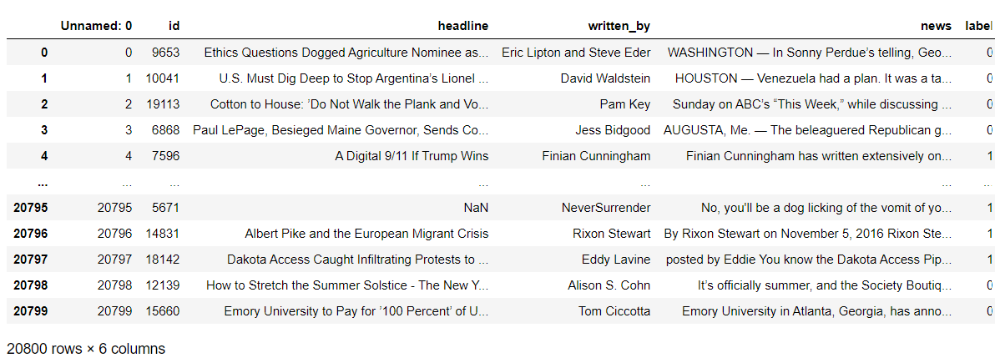
Dataset
The figure shows how the given dataset looks like

Slide 5
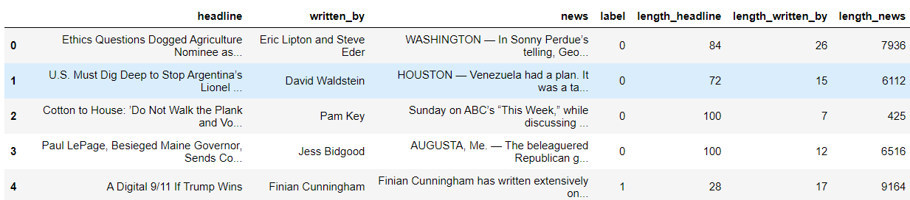
Calculated Lengths of Features

Slide 6
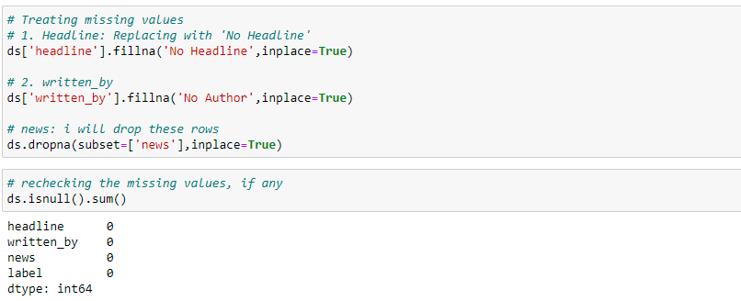
HANDLING MISSING VALUES

Slide 7
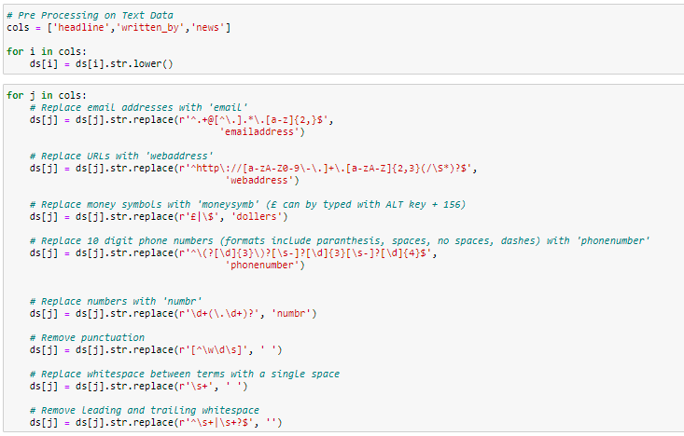
Using NLP to Solve Problem
Here the idea is to vectorize the contents so that the meaning of the article can be understood by the machine. The following pre-processing steps were done:

Slide 8
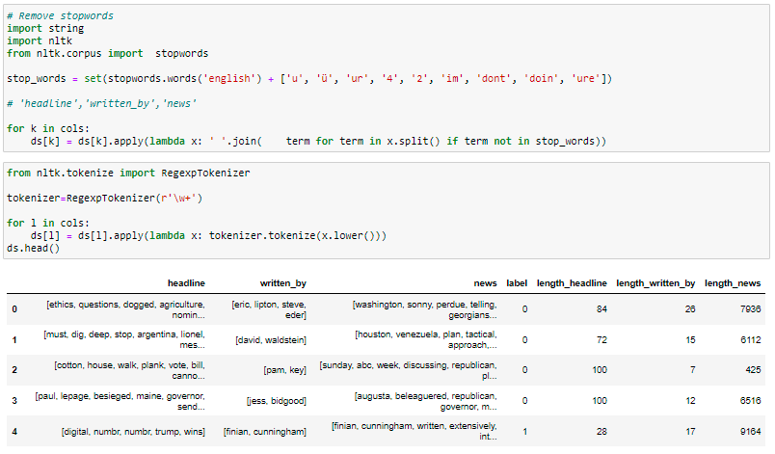
Stop Words Removal
We need to remove words like for, of, the etc. which do not actually add to the context so that our processing speed is reduced

Slide 9
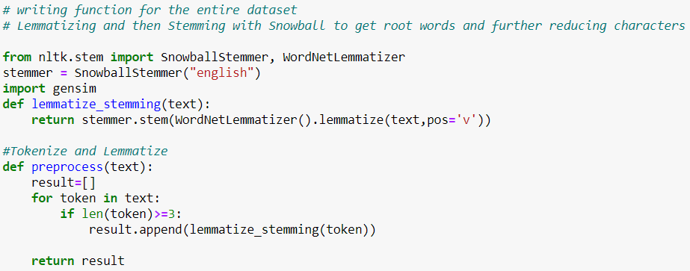
I have performed lemmatization and stemming on the features – Headline and news. This is done to find the root words.

Slide 10
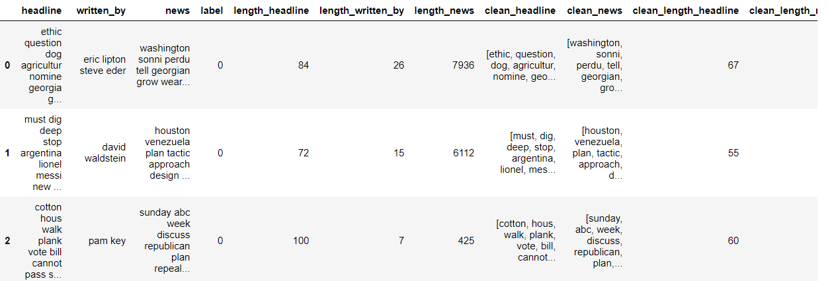
Finally, we can see the counts of actual data and data after pre-processing

Slide 11
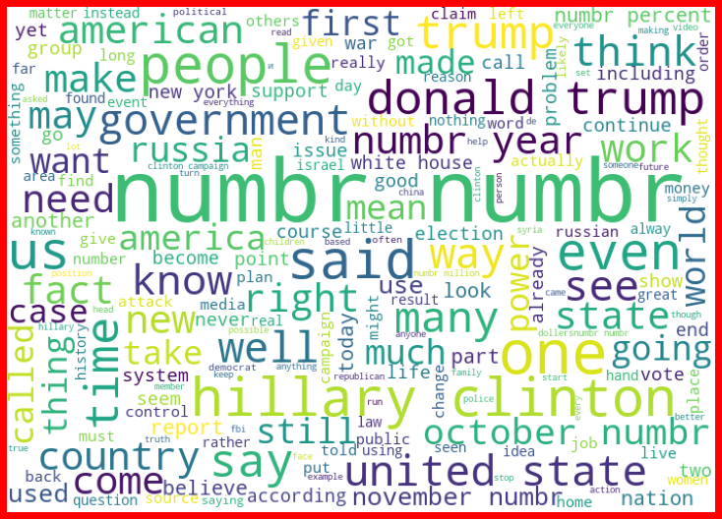
Word Cloud for Fake News for News Column

Slide 12
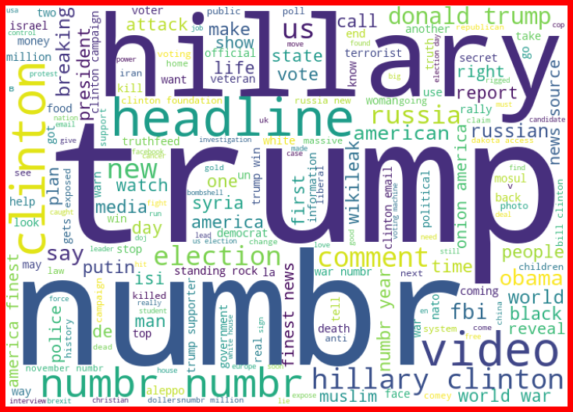
Word Cloud for Fake News for Headline Column

Slide 13
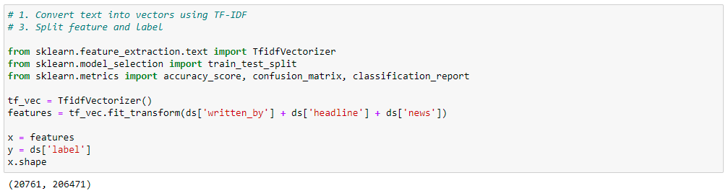
Next, I have vectorized using tf-idf vectorizer so that words are arranged in a 2-d area based on similarity or difference in their meaning
Also, prepared X and y variables for model building

Slide 14
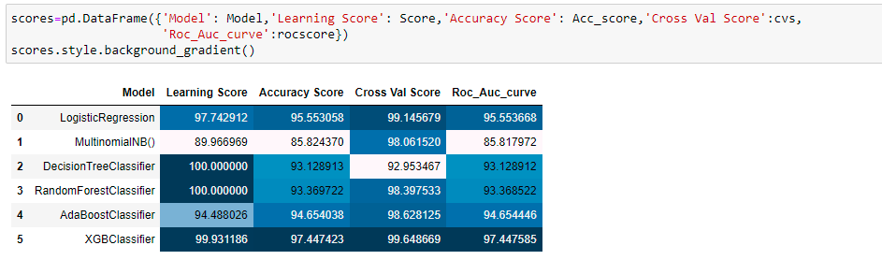
Let’s have a look at the Model Performances

Slide 15
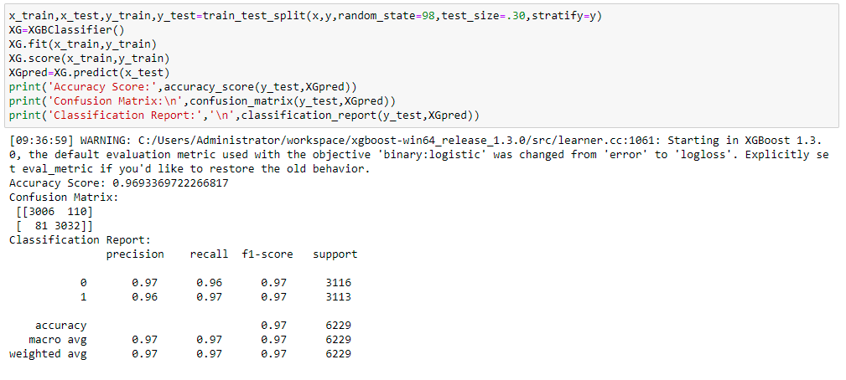
Final Model

Slide 16
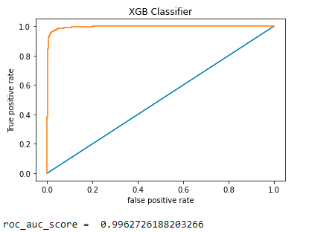
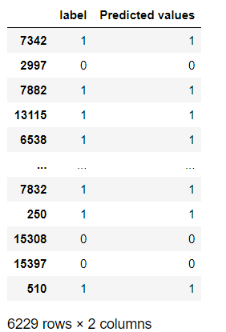
Roc_Auc Score and Predicted Values

